Slide 1
Modern web development with ASP.NET Core & Blazor in .NET 11
Daniel Roth
Principal Product Manager, Microsoft
Notes:
Hi everyone! I'm Daniel Roth, Principal Product Manager for ASP.NET Core and Blazor on the .NET team.
In this session, we'll explore modern web development with ASP.NET Core and Blazor in .NET 11.

Slide 2
ASP.NET Core & Blazor:
a platform you can trust
Trust to
Trust to
Trust to
Perform
Protect
Deliver
Proven performance at scale.
Built-in protections as threats evolve.
Frameworks and tools that work together.
.NET 11: Faster apps. Stronger protections. More productive teams.
02
Notes:
Choosing a web platform is a long-term investment.
You need a platform you can trust:
- trust to perform at scale
- trust to protect from evolving threats
- trust to help you deliver as demands increase
In .NET 11, ASP.NET Core and Blazor help you build faster apps, strengthen protections, and make your teams more productive.

Slide 3
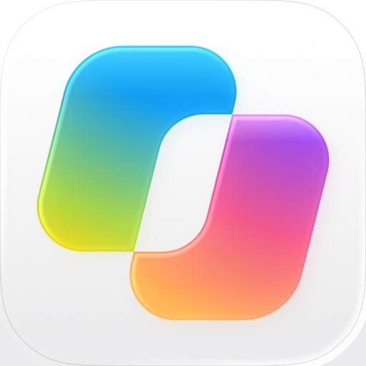




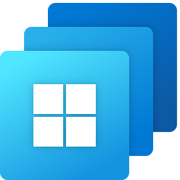
PERFORMANCE / MICROSOFT SCALE
.NET is trusted at Microsoft scale
A platform we depend on ourselves
Microsoft
Copilot
Microsoft
Teams
Bing
Azure
Microsoft
365
Xbox
Microsoft
Entra
Windows
365
Microsoft
Intune
03
Notes:
Let's start with performance.
.NET powers services across Microsoft, from Copilot and Teams to Bing, Azure, and Xbox. It's a platform we depend on ourselves.
The performance work we do across the runtime and web stack is driven by real Microsoft workloads operating at hyperscale.
These are real production workloads, not just framework benchmarks. They handle billions of requests and millions of users for business-critical scenarios every day.

Slide 4
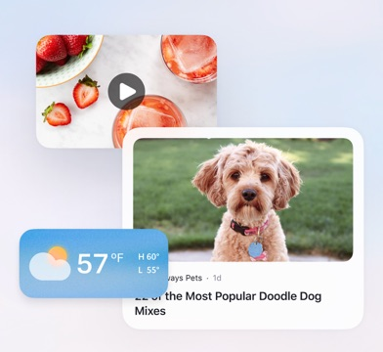
PERFORMANCE / MICROSOFT FEEDS
MSN feeds: powered by .NET
Proven at hyperscale
Continued investment.
Measurable gains.
Tens of billions
monthly page views (historical)
.NET 8 to .NET 10
29%
lower P95
GC pauses
Personalized
feeds in
11%
lower async
plugin latency
MSN
Edge
Windows
20%
shorter
thread-pool queues
04
Notes:
For example, .NET powers personalized content feeds across MSN, Edge, and Windows. These feeds have served tens of billions of monthly page views.
And they keep benefiting from .NET investment. After upgrading from .NET 8 to .NET 10, this team reported 29 percent lower P95 GC pauses, 11 percent lower async plugin latency, and 20 percent shorter thread-pool queues.
You don't need Microsoft's traffic volume to benefit from that investment. Your applications can benefit from the same runtime improvements and optimizations.

Slide 5
PERFORMANCE / SUSTAINED INVESTMENT
ASP.NET Core performance in .NET 11
Smarter execution
An async foundation
Faster data processing
JIT optimizations and
reduced allocation pressure
Runtime async in framework
libraries; application opt-in
JSON, UTF-8, strings,
spans, and regex
Efficient networking
Lower-cost diagnostics
Efficient Blazor apps
Earlier HTTP/3 processing;
cheaper bad-request paths
Tracing, metrics, logging,
and async profiling
WASM trimming, static SSR
caching, pausable circuits
Many gains arrive by upgrading. New capabilities help you optimize further.
devblogs.microsoft.com/dotnet/performance-improvements-in-net-11/
05
Notes:
In .NET 11, we’ve improved performance across the web stack: more efficient runtime execution, faster data processing and HTTP handling, and lower-overhead observability.
For Blazor, that means smaller WebAssembly downloads, caching for static SSR, and the ability to pause idle server circuits to free resources.
Many of these improvements come simply by upgrading.

Slide 6
PERFORMANCE / KESTREL IN .NET 11
Reduce bad-request overhead in .NET 11
Kestrel rejects malformed HTTP/1.1 requests with less processing overhead.
PREVIOUS PATH
Parse failure
Throw and
propagate
Normal response
setup
Reject request
.NET 11 OPTIMIZED PATH
Parse failure
Return an
error result
Static response
fragments
Reject request
~30%
higher bad-request throughput
Single-core perf lab | HTTP behavior and diagnostics preserved
Sources:
#65221
#65256
#65345
06
Notes:
Let's make that concrete with one improvement in Kestrel.
In .NET 11 we reduced the overhead of rejecting bad requests, leaving more capacity for the good ones.
Previously, Kestrel threw and propagated exceptions for malformed HTTP requests, then went through its normal response setup to reject them.
Now, the parser returns an error result, and Kestrel can write the response from preallocated fragments. Same HTTP behavior and diagnostics, with less work.
In our single-core benchmark, that improved bad-request throughput by roughly 30 percent.

Slide 7
SECURITY / MAINTAINED PROTECTIONS
ASP.NET Core security in .NET 11
Stronger defaults. Defense in depth.
Safer request defaults
Authentication stays current
Automatic CSRF protection
SignalR and Blazor Server refresh
Consistent authorization
Stronger transport protection
MVC, SignalR, and Blazor metadata
Supported TLS channel binding
Better CSP compatibility
Hardened request handling
Blazor templates and components
HTTP/2-3 timeouts; rate-limit fixes
Stronger defaults and maintained protections complement your application's security design.
07
Notes:
That’s performance. Next let's look at how the platform helps protect your app and users.
Security isn't something we finish in one release. Browsers evolve, authentication patterns change, and attackers look for new ways in.
We keep improving the infrastructure your applications rely on, so your team can build on existing protections rather than implementing everything itself.
In .NET 11, that includes automatic cross-site request forgery (CSRF) protection, more consistent authorization metadata handling, and authentication refresh for long-lived connections.
We’ve also strengthened transport and request handling and improved Blazor's compatibility with restrictive Content Security Policies.
Your application still needs a sound security design and configuration. But with .NET you are building on a secure foundation.

Slide 8
SECURITY / SAFER REQUEST DEFAULTS
Automatic CSRF protection
Modern browser forms: Fetch Metadata instead of antiforgery tokens.
Browser-supplied request context
~4×
Sec-Fetch-Site: same-origin
Origin fallback when needed
form-post requests/sec
vs token validation
Built-in CSRF protection
~65% less allocation
Rejects untrusted cross-origin forms
per request
No tokens to generate. No tokens to validate.
Accepted form-post benchmark vs token validation | aspnet/Benchmarks#2181
08
Notes:
Sometimes stronger protection also means less work. Automatic CSRF protection is a great example.
CSRF protection ensures that requests comes from your application, not another site misusing the signed-in browser.
For modern browsers, .NET 11 uses browser Fetch Metadata headers to automatically detect and block forged requests. The protection is enabled by default. No need to generate and check antiforgery tokens.
Skipping that token work is also a performance win. In our benchmarking, the new header-based approach handles about four times as many requests per second, with about 65 percent less allocation per request, compared with antiforgery token validation.
Less plumbing, less overhead, and protection built into the platform. Let's see it in action.

Slide 9
Demo
Auto CSRF protection
Notes:
1. Show order 48021 in the return editor. Select USB-C Dock Pro+, wait for the availability check, and select Review replacement. Show the review page with the replacement still marked Draft; do not confirm yet.
A representative is arranging a replacement. We've checked availability and reached the final review. Confirmation is a normal form post, with no antiforgery token in the form.
2. Select Open cross-origin test. In the new tab, open Network, enable Preserve log, and select Attempt cross-origin confirmation.
This other origin tries to submit the same confirmation using that browser session.
3. Inspect POST /returns/confirm: show HTTP 400, Sec-Fetch-Site: same-site, the different Origin, and the eShop.CustomerService.Demo authentication cookie.
The request returns 400. The authentication cookie is still present, but the origin is different and isn't trusted.
4. Return to the original tab and refresh. Verify that the draft is still Draft and Confirm replacement remains available.
Nothing was confirmed.
5. Select Confirm replacement. Show the completed replacement and its activity entry.
Back in our application, the same-origin confirmation succeeds.
6. Show /returns/confirm in Program.cs, highlighting [FromForm] Guid draftId and RequireAuthorization. Show the plain form in Review.razor, including its hidden draftId and absence of an antiforgery token. Return to the slides.
The endpoint binds the form data and still requires authorization. We haven't added token generation or validation code; the framework supplies the CSRF protection based on the fetch metadata headers provided by the browser.
That's the platform helping protect the user's intent, without extra token plumbing.

Slide 10
SECURITY / AUTHENTICATION REFRESH
Long-lived connections. Short-lived credentials.
SignalR authentication refresh in .NET 11
Same SignalR connection
Credentials
Refresh
Refresh
Token 1
Token 2
Token 3
Short-lived
Short-lived
Short-lived
Reauthenticate before expiration
Blazor Server: updated permissions, preserved work.
Your app obtains credentials. SignalR reauthenticates.
10
Notes:
We also improved how authentication is handled for long-lived connections.
SignalR connections can outlive their credentials. That can mean continuing with outdated authentication state.
In .NET 11, SignalR can reauthenticate an existing connection with fresh credentials, without reconnecting. Your application obtains those credentials. SignalR uses them to update the connection's principal. Blazor Server uses that same machinery to keep authentication state current while preserving the user's work.

Slide 11
SECURITY / AUTHENTICATION REFRESH
Enable authentication refresh
Server and JavaScript client configuration
Server (.NET)
Client (JavaScript)
app.MapHub<UpdatesHub>(
"/updates", o =>
{
o.EnableAuthenticationRefresh
= true;
o.CloseOnAuthenticationExpiration
= true;
});
new signalR.HubConnectionBuilder()
.withUrl("/updates", {
accessTokenFactory:
getAccessToken
})
.withAuthenticationRefresh()
.build();
Blazor Server enables refresh on its endpoint and client.
Existing authenticated hub; getAccessToken supplies your app's current token.
11
Notes:
For your own SignalR hub, enable authentication refresh on the server. Close-on-expiration prevents a connection from retaining expired authentication if refresh fails.
The JavaScript client opts into automatic refresh. The .NET client enables it by default.
Blazor Server enables automatic refresh on its endpoint and client for you.

Slide 12
Demo
Authentication refresh
Notes:
Let's see it preserve a user's work.
1. Switch to the staged return 48022 editor. Show Refund approval: allowed, USB-C Dock Pro+, the unsaved address 200 Demo Way, and Editor instance.
Taylor is editing another replacement in our normal cookie-authenticated workspace.
2. In Visual Studio, show ResolutionEditor.razor: the AuthorizeView around the refund action, the cascading Task<AuthenticationState>, and (await AuthenticationState).User and Authorization.AuthorizeAsync in SaveAsync. Do not open the demo authentication implementation.
var user = (await AuthenticationState).User;
if (resolution.Value is RefundResolution
&& !(await Authorization.AuthorizeAsync(user, DemoAuthentication.RefundPolicy)).Succeeded)
{
error = "Refund approval is required. Your unsaved work has been preserved.";
return;
}
The refund policy is evaluated against the authenticated user. Blazor supplies that user through authentication state. AuthorizeView controls the action, and the save handler enforces the same policy on the server.
3. Return to the editor and select Refund without saving. Show that Review refund is available.
The session currently allows refunds.
4. In permission controls, select Remove refund approval. Return to the editor without reloading; wait for Refund approval: removed and the warning replacing Review refund.
This other tab issues an updated cookie without refund approval. The existing workspace picks up those credentials at its next scheduled authentication refresh.
5. Show a successful POST /_blazor/refresh returning HTTP 200, while the original WebSocket remains open and no new WebSocket appears.
The browser sends its current cookie on this separate HTTP request. SignalR updates the existing connection's user, and Blazor updates the component's authentication state.
This sample uses a short reauthentication window, not a short sign-in cookie, to make the update visible. It isn't automatic monitoring of role changes elsewhere.
6. Select Restore refund approval in the controls tab. Return without reloading; wait for Refund approval: allowed and Review refund to return.
The controls issue another updated cookie, and refund approval returns on the same connection.
7. Select Replacement. Show the unchanged product, address, and Editor instance. Do not save or select Review replacement.
Our application supplied updated credentials. The framework applied them without losing the user's work.
8. Leave refund approval allowed, close the permission-controls tab, and return to the slides. Do not save the replacement; keep order 48022 open for Razor tooling.

Slide 13

PRODUCTIVITY / PLATFORM STRENGTHS
Productivity across the web stack
{ }
Web APIs
Web UI
Tooling & AI
Minimal APIs,
typed contracts,
and built-in validation
Blazor components,
server-rendered pages,
and JavaScript frontends
Razor, Hot Reload,
and AI-assisted coding
ASP.NET Core | C# | Shared libraries
13
Notes:
Lastly, let’s talk about productivity. Trust in a platform also means knowing that your team can build and maintain applications effectively.
ASP.NET Core helps your team build APIs and web UI using shared C# skills, libraries, and tooling.
Razor tooling, Hot Reload, and AI assistance help you iterate faster using your favorite coding tools.

Slide 14
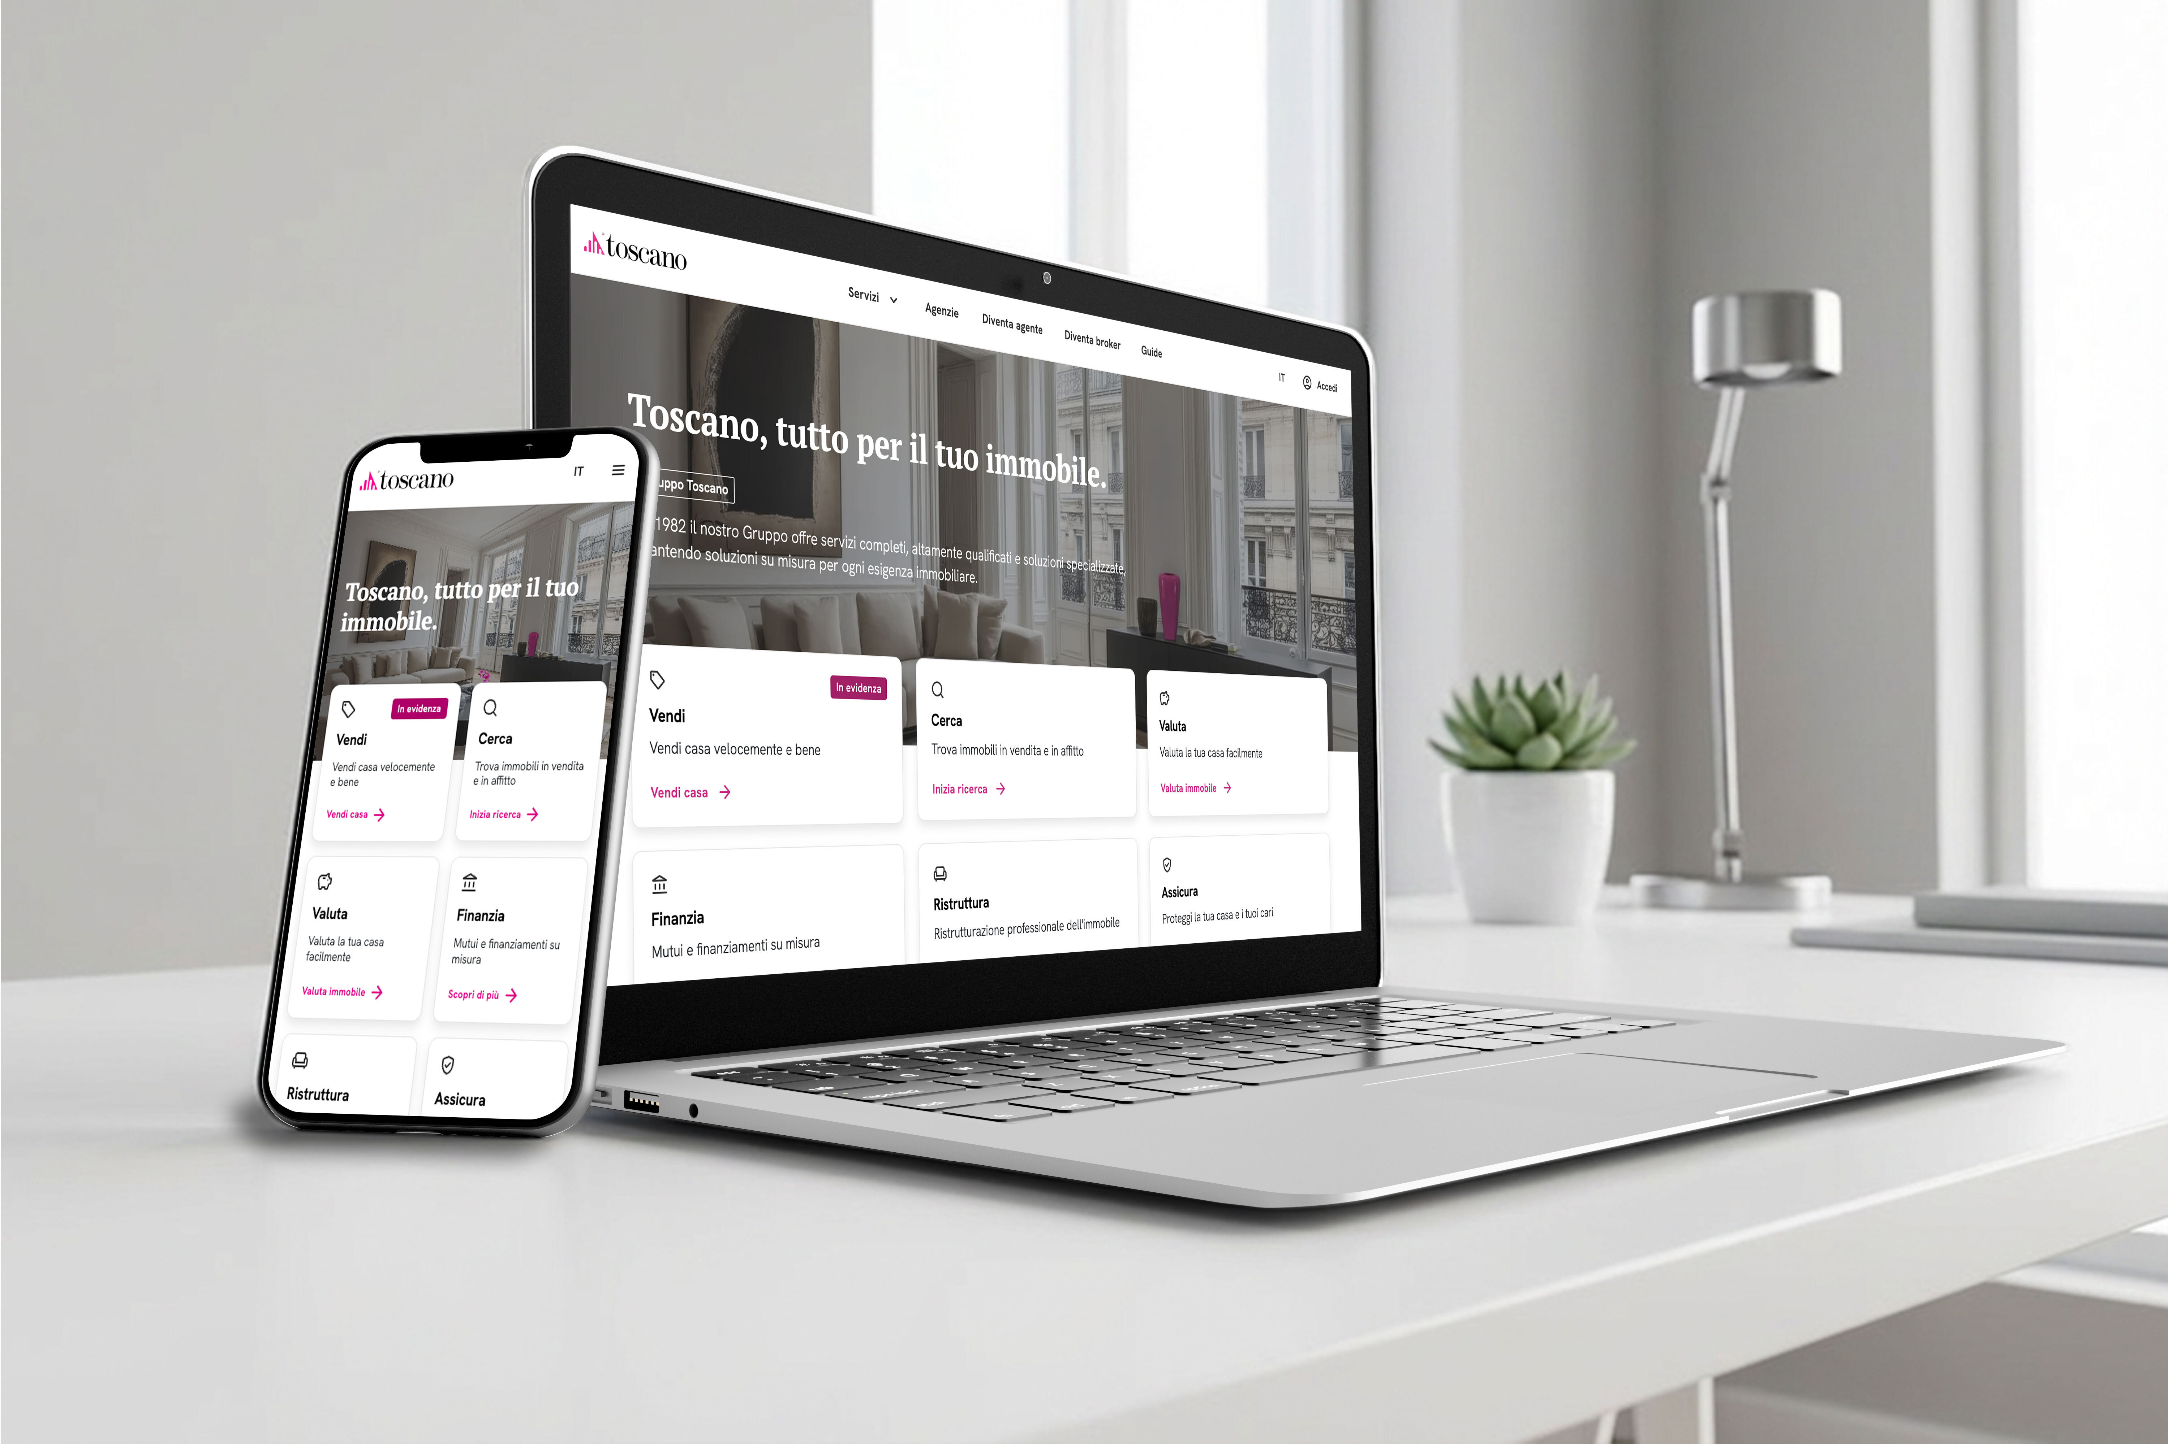
PRODUCTIVITY / CUSTOMER STORY
Small team. Big reach.
Toscano Digital | Real-estate search and listings
5
developers
4.6M
sessions / year
11M
page views / year
Customer-reported figures | dotnet.microsoft.com/platform/customers/toscano
14
Notes:
What can that mean for a small team? Toscano Digital provides a great example.
Toscano’s small team of five developers built a public real-estate portal serving 4.6 million sessions and 11 million page views annually, alongside their Blazor-based CRM.
Their requirements included search discoverability, mobile performance, and rich interactivity. They combined .NET and Blazor rendering strategies to meet those needs.
They were able to be more productive by leveraging C# full stack and also the many built-in features in the .NET platform.

Slide 15


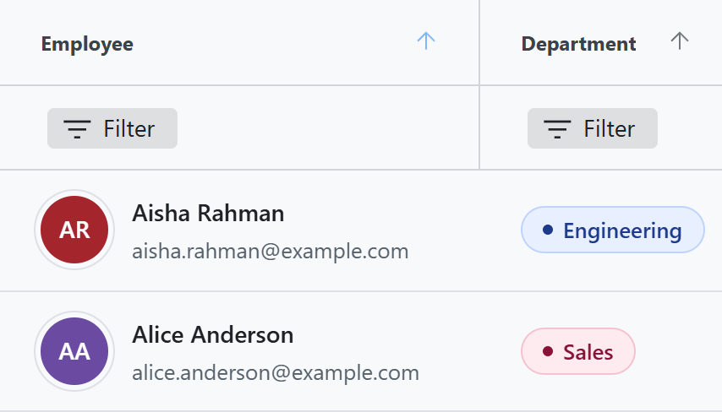
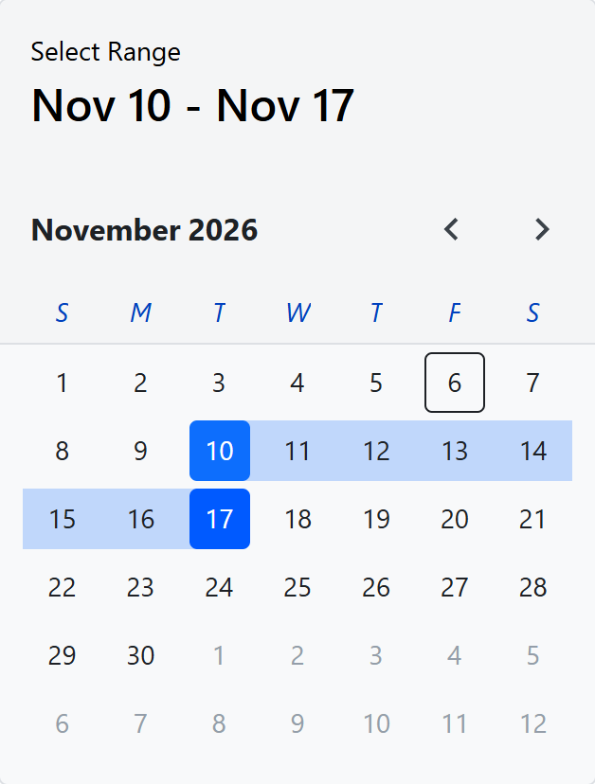
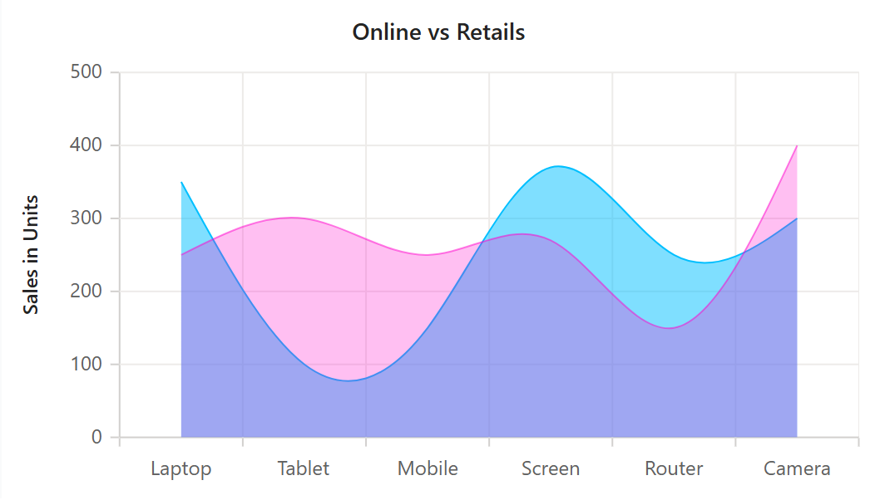
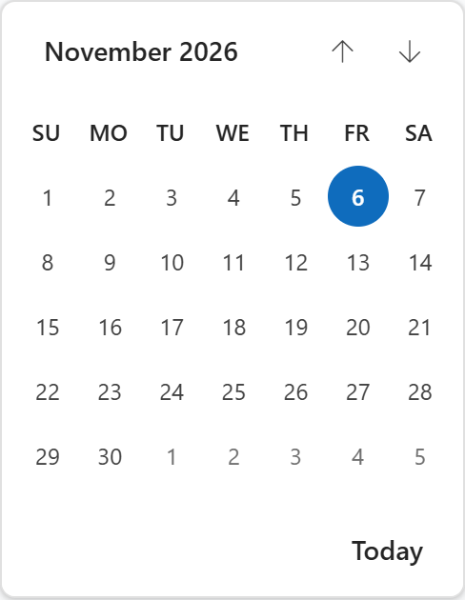
PRODUCTIVITY / BLAZOR PARTNERSHIPS
Great partners. A stronger Blazor.
Ignite UI for Blazor
Syncfusion Toolkit for Blazor
50+ free, open-source components
Free, open-source Blazor toolkit
CONTRIBUTING TO BLAZOR
CONTRIBUTING TO BLAZOR
New Blazor analyzers in .NET 11
Framework fixes, tooling + testing
MIT licensed. Free for commercial use. Separate from the partners' commercial suites.
15
Notes:
It also helps to be able to build on a great ecosystem. A huge thank-you to Infragistics and Syncfusion. They're not just building on Blazor; they're helping build Blazor.
Infragistics has made more than 50 Ignite UI for Blazor components free and open source, including Grid Lite, inputs, navigation, and layouts.
Syncfusion has released the free, open-source Syncfusion Toolkit for Blazor, with charts, inputs, calendars, and dialogs.
Both libraries are MIT licensed, including for commercial use. These are separate open-source offerings, not their complete commercial suites.
Their engineers are also investing directly in the platform. Infragistics contributed new Blazor analyzers in .NET 11 that catch common coding mistakes. Syncfusion contributed framework and scaffolding fixes, clearer diagnostics, and substantial testing of new Blazor features.
Those framework contributions benefit every Blazor developer, whichever components they use.

Slide 16
PRODUCTIVITY / API TO UI
A clear model becomes a clear contract
[JsonUnion(TypeClassifier = typeof(JsonUnionTypeStructuralClassifier))]
public union Resolution(RefundResolution, ReplacementResolution);
Refund JSON
Replacement JSON
{ "amount": 149,
"paymentReference": "PAY-48021"
}
{ "productCode": "DOCK-PRO-PLUS",
"deliveryAddress":
"120 Market Street, Seattle, WA 98101"
}
Generated OpenAPI 3.2: Resolution
{ "type": "object", "anyOf": [
{"$ref": "#/components/schemas/RefundResolution"},
{"$ref": "#/components/schemas/ReplacementResolution"}
] }
Actual demo responses and generated Resolution schema; referenced case schemas omitted.
16
Notes:
Let's look at some of the productivity improvements in .NET 11, starting with C# unions and API contracts.
ASP.NET Core in .NET 11 supports C# unions for both API and web UI development. For APIs, System.Text.Json handles serialization, and ASP.NET Core generates OpenAPI schemas that describe the union's possible cases. You can also use C# unions in your Razor views and Blazor components.
Here, our API returns either a refund or a replacement. System.Text.Json serializes the active case, and the generated OpenAPI schema describes both possibilities.

Slide 17
Demo
C# unions
Notes:
1. Show Resolution.cs: the union, structural JsonUnion classifier, and both case records.
Here's the actual refund-or-replacement contract.
2. Send requests 1 and 2 in Demo.http. Compare the refund and replacement response bodies.
System.Text.Json writes the active case as ordinary JSON, without a union wrapper or discriminator.
3. Send request 3. Show openapi: 3.2.0, then Resolution and its two anyOf references. Return to the slides.
The generated contract carries those alternatives to API consumers. .NET 11 generates OpenAPI 3.2 by default.

Slide 18
PRODUCTIVITY / SHARED VALIDATION
Async validation, from API to UI
Await real business checks. Reuse the same rules.
Reusable attributes
Object-level validation
AsyncValidationAttribute
Task<ValidationResult?>
IsValidAsync(...)
IAsyncValidatableObject
IAsyncEnumerable<ValidationResult>
ValidateAsync(...)
Reusable property-level rules
Checks involving several fields
Minimal APIs
Blazor forms
Abbreviated API signatures. Keynote demo: the shared async inventory attribute.
18
Notes:
Business rules often need an asynchronous lookup.
In .NET 11, Data Annotations includes new async validation APIs. AsyncValidationAttribute supports reusable rules. IAsyncValidatableObject supports object-level checks, including rules involving several fields.
Minimal APIs and Blazor support both. Let's use an inventory check to see how the same rule works from API to UI.

Slide 19
Demo
Async validation
Notes:
1. Show ReplacementRequest.cs: Required, InStock, the AsyncValidationAttribute base, and the awaited inventory lookup.
This product code is correctly shaped. Whether we can fulfill it requires a real inventory check.
2. Show AddValidation and the replacement-validation endpoint in Program.cs. Send request 4 in Demo.http: show HTTP 400 and errors.ProductCode. Send request 5: show HTTP 200.
Minimal APIs await the rule before the handler runs. The unavailable model fails; the available alternative passes.
3. In the return 48021 editor, select USB-C Dock Pro and show the pending check and unavailable message. Select USB-C Dock Pro+ and show successful availability.
The same attribute also works with Blazor's built-in DataAnnotationsValidator. The representative sees pending validation and useful feedback.
4. Show EditForm and DataAnnotationsValidator in ResolutionEditor.razor. Return to the slides without saving or confirming a replacement.
Checking availability isn't reserving inventory. The server still enforces the rule when we commit.

Slide 20
PRODUCTIVITY / BLAZOR VIRTUALIZATION
Big lists. A steady experience.
Built-in list behavior, without custom scrolling infrastructure.
Variable-height items
Anchor modes
Expand details.
Let rows grow with their content.
Follow the start, end,
both, or neither edge.
Jump to a row
Position stability
ScrollToItemAsync(index)
Keep visible context
as items change around it.
Blazor Virtualize in .NET 11: measured row heights and maintained reading position.
20
Notes:
Blazor helps you display large lists of data with the built-in Virtualize component, which renders just the items in and around the visible area and updates them as you scroll.
In .NET 11, Virtualize now handles variable-height items, so rows can grow with their content.
Anchor modes control following at the edges. We can jump directly to a row, and improved scroll stability keeps the representative's context in view as the list changes.

Slide 21
Demo
Blazor virtualization
Notes:
1. Switch to Service queue. Leave the row number at 5000 and select Jump. Show the highlighted Jump target.
This is the same customer-service workspace, with ten thousand simulated queue entries linked to our seeded returns.
2. Select Expand preceding row, then Add at start. Keep the highlighted target in view.
Earlier details grow, and new entries arrive above us. The same case stays in place. These rows don't need a fixed height.
3. Select Go to end. After the jump, select Neither edge, then End of queue, and Add at end.
At the end, we can follow new arrivals instead. The framework handles that anchoring policy.
4. Show Virtualize, AnchorMode, and ScrollToItemAsync in ServiceQueue.razor. Return to the slides.
That's scrolling infrastructure our team doesn't have to build.

Slide 22
PRODUCTIVITY / RAZOR WORKFLOW
Stay in flow with Razor
Author
Iterate
Stay consistent
More C# code actions
Cross-language rename
Formatting controls
Generate code &
implement types
C# types + Razor components
HTML attribute indentation
C# style via EditorConfig
Add component files
Improved Hot Reload
C# using directives
.razor.cs, .razor.js, .razor.css
Faster, more reliable updates
Remove, sort, fade unused
Shorter syntax,
same asset
<img src="~/images/logo.svg" />
<img src="@Assets["images/logo.svg"]" />
22
Notes:
Now let's look at the tools your team uses every day.
Razor keeps you in flow while building great web UI. Razor tooling in Visual Studio and VS Code offers richer code actions, refactoring across C# and Razor, and faster Hot Reload. You can apply C# formatting preferences through EditorConfig, sort using directives, and remove unused ones.
Shorter ~/ asset paths save typing and make your markup easier to read.

Slide 23
Demo
Razor tooling
Notes:
Let's add a customer follow-up checklist to the return editor, without restarting the app.
1. Keep order 48022 open on Replacement, with USB-C Dock Pro+ selected and an unsaved delivery address of 200 Demo Way. Open only eShopCustomerService.Web\Components\Shared\ResolutionEditor.razor. Immediately before the <div> with class="resolution-choices", type h3+ul>li*3 and press Tab. Fill the heading with Customer follow-up and the three items with Confirm symptoms, Check replacement availability, and Review before confirmation. Do not save yet.
Emmet gives me the markup for a customer follow-up checklist.
2. In the same file, invoke Remove and Sort Usings, then Format Document. Show the unused @using System.Text removed, the nearby heading markup aligned, and @if(error is not null) becoming @if (error is not null) according to .editorconfig. Stay near the heading; no file switch or scrolling to the handler is needed.
I can clean up using directives and format the actual component, including my shared C# preferences.
3. Save ResolutionEditor.razor once. Show Customer follow-up appear in the already-open return editor through Hot Reload. Do not refresh, restart, or navigate. Point out that the selected product, unsaved address, and Editor instance remain unchanged.
Hot Reload adds the checklist to the running app. The selected product and unsaved address are preserved.
4. Return to Slide 24. Between rehearsals, stop the demo app, close ResolutionEditor.razor, and use the single-file git restore command in the repository's README.md on demo/razor-tooling. No manual code staging is needed.
Small improvements you use all day.

Slide 24
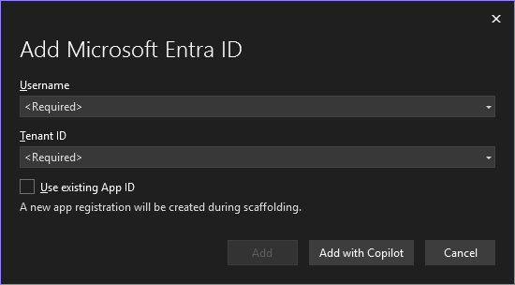
PRODUCTIVITY / MICROSOFT ENTRA ID
Add Entra ID to an existing Blazor Web App
Scaffold authentication with Visual Studio or the command line
Visual Studio
dotnet scaffold
Guided authentication tooling
An equivalent CLI workflow
Pick a scaffolding category:
API
Aspire
Blazor
> Entra ID
Identity
MVC
Razor Pages
(Show All)
Your application still owns authorization policies and production identity configuration.
24
Notes:
Adding sign-in also has productive tooling. Visual Studio and dotnet scaffold can add Microsoft Entra ID authentication to an existing Blazor Web App.
The scaffolder helps with app registration, packages, and configuration. Your team still owns authorization policies and production identity configuration.

Slide 25
PRODUCTIVITY / AI-ASSISTED DEVELOPMENT
Bring .NET expertise to your coding agent
GitHub Copilot collaboration
ASP.NET Core plugin
Blazor plugin
.NET plugin
dotnet-aspnetcore
dotnet-blazor
dotnet
APIs, middleware,
authentication, SignalR
Components, forms,
rendering, interop
General .NET skills
C# LSP with Razor
Comprehensive evaluations
Refined as models and tools change
Get started: github.com/dotnet/skills
25
Notes:
We've also been working closely with the GitHub Copilot team to improve the .NET and C# development experience.
One way we bring .NET expertise into the AI-assisted development workflow is through the plugins in dotnet/skills.
The ASP.NET Core and Blazor plugins provide specialized skills for APIs, components, forms, authentication, rendering, and interop.
The core dotnet plugin adds general .NET skills and C# language intelligence, including Razor support.
We back these skills with a comprehensive evaluation suite and keep refining them as AI models and coding tools change.
To get started, visit github.com/dotnet/skills for the plugins and setup instructions.

Slide 26
PRODUCTIVITY / CONNECTED DEVELOPMENT
Connected development with Blazor & Aspire
Less plumbing. More capable apps.
Aspire integration
Blazor Gateway
Web Workers
Build & debug
together
Host
consistently
Keep the UI
responsive
Dashboard & telemetry
Configuration
Service discovery
WebAssembly debugging
Development & production
Optimized static assets
API proxying
Config & telemetry
Compute-intensive work
Run .NET off the UI thread
Keep interacting
Integrated development. Consistent hosting. Responsive apps.
26
Notes:
You can further elevate your web development experience with Aspire. Aspire helps your team connect, run, and debug the whole application.
That now includes Blazor WebAssembly, so you can debug the browser client and backend together, with configuration, service discovery, and telemetry integrated into the experience.
The new Blazor Gateway provides a consistent host for that client in development and production.
Inside the browser, Web Workers let you move compute-intensive .NET work off the UI thread, so users can keep interacting while that work runs.

Slide 27
Demo
Blazor + Aspire
Notes:
Let's bring partner components and connected tooling together in a customer-support app.
1. Show eShop device support, case ES-1048, USB-C Dock Pro. Point to the diagnostic bundle picker and support notes.
The customer's displays keep disconnecting. They've exported a diagnostic bundle, and we can analyze it here in the browser without uploading the raw logs.
2. Select the downloaded synthetic demo bundle. Hit the breakpoint on GetFromJsonAsync in Services\DiagnosticCatalogClient.cs, inspect productId as DOCK-PRO, and continue. Briefly show the client's Program.cs registration using https+http://diagnostics.
This is C# executing in WebAssembly, debugged from Visual Studio. The browser asks the backend for product rules using a logical service name, not a hard-coded address.
3. In the Aspire dashboard, show app, gateway, and diagnostics. Open the catalog request's correlated browser → Gateway → API trace, then return to the workbench.
Aspire connects the client, Gateway, and API, including service discovery and telemetry. The Gateway hosts the WebAssembly app; it isn't a separate host we had to build.
4. Select Analyze on UI thread and try typing a support note during processing. Show the findings and timeline when it finishes.
We're decompressing, parsing, and correlating local diagnostic events in C#. On the UI thread, that work competes with the interface.
5. Select Analyze in Web Worker and keep typing in the support note while the analysis runs. When it finishes, show Identical findings verified in both modes and the two timings.
The worker runs the same C# algorithm in the background, so I can keep working. The benefit is responsiveness, not necessarily faster analysis.
6. Filter the findings by Display and point to the timeline. Name Infragistics Grid Lite and Combo Box and the Syncfusion Toolkit chart.
These are the partners' free, open-source components, turning the local evidence into useful findings and next steps.
7. In Aspire metrics for app, show diagnostics.analyses.completed and diagnostics.analysis.duration, split by execution.mode: main_thread and web_worker. Allow five seconds for export if needed, then return to the slides.
We can observe both execution modes in Aspire. The telemetry contains counts and timings, not raw logs or support notes.
Connected development, local .NET processing, and an interface that stays responsive.

Slide 28
ASP.NET Core & Blazor in .NET 11
Faster apps. Stronger protections. More productive teams.
Perform
Protect
Deliver
Faster runtime,
JSON & Kestrel
Automatic CSRF
protection
Unions + OpenAPI 3.2
Async validation
WASM trimming
Zstandard support
SignalR auth refresh
Live connections
Static SSR validation
TempData, QuickGrid
Blazor pause & cache
Virtualize upgrades
Authorization
metadata consistency
Razor, Entra & AI skills
Aspire + Web Workers
Native telemetry
Async profiling
CSP + transport
hardening
Partner components
Agentic UI*
* Blazor AI components are experimental. Aspire, tooling and partner libraries ship separately.
28
Notes:
I hope you enjoyed learning about modern web development with ASP.NET Core and Blazor in .NET 11!
Choosing a web platform is a long-term investment. You need one you can trust to perform, protect your users, and help your team deliver.
With ASP.NET Core and Blazor in .NET 11, we're building on a foundation proven at Microsoft scale: making your apps faster, strengthening built-in protections, and helping your team stay productive as your needs grow.

Slide 29
COMPANION SESSIONS / BLAZOR
More to explore with Blazor
Two companion sessions to take the ideas further.
Blazor Server in .NET 11: Fast, resilient, and scalable
November 11, 2026 | 10:30-11:00 AM PST
Fast pages, resilient sessions, efficient scale.
Building the future of agentic UI with Blazor
November 11, 2026 | 12:00-12:30 PM PST
Rich interfaces for human-agent collaboration.
More from .NET Conf 2026 | Blazor AI components are experimental.
29
Notes:
To learn more about the improvements for web developers in .NET 11, join me for two more sessions at .NET Conf.
In "Blazor Server in .NET 11", we'll go deeper on fast page loads, resilient sessions, and efficient scaling.
And in "Building the future of agentic UI with Blazor", we'll explore how the experimental Blazor AI components help you build rich interfaces for human-agent collaboration.

Slide 30
Download .NET 11
Start building with
ASP.NET Core & Blazor
get.dot.net/11
Thank you!
Perform. Protect. Deliver.
Notes:
Take the next step: download .NET 11 at get.dot.net/11.
Start using it in an existing application, or build your next web project with ASP.NET Core and Blazor.
Thank you for watching, and enjoy .NET Conf!

